Slide 1
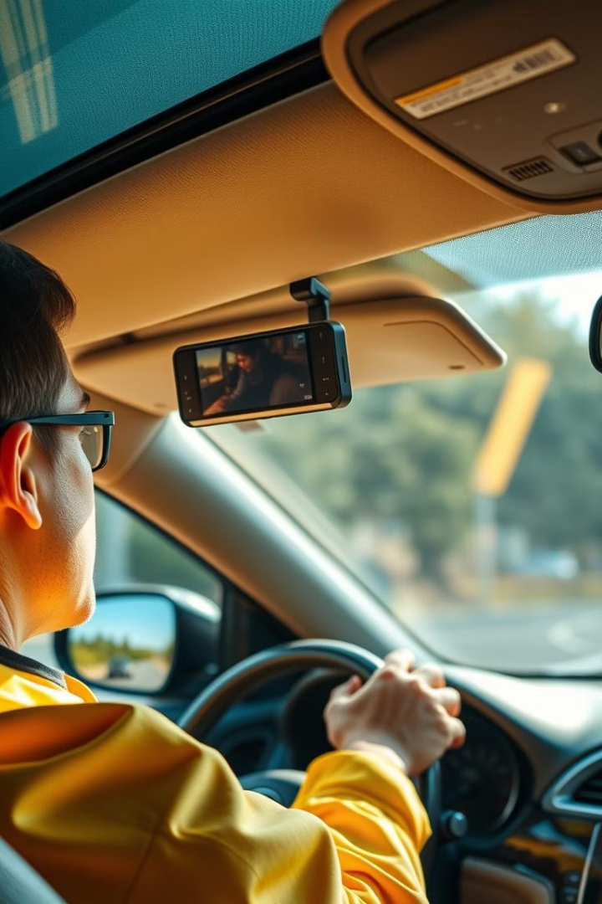

Driver Drowsiness Detection System: Enhancing Road Safety Through Computer Vision
Addressing the danger of driver fatigue with an intelligent, real-time system. Improving safety for truck drivers, taxi services, and night travelers.
by Swastik Sirvastava
by Sarthak Anand

Slide 2
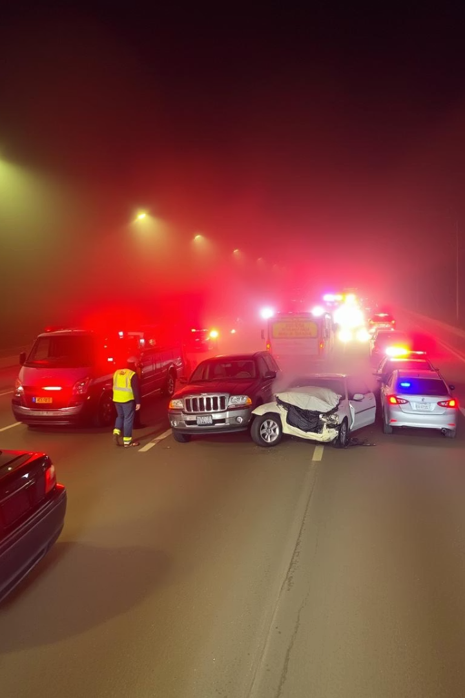
The Problem: Drowsiness and Road Accidents
Fatal Risk
Drowsiness causes 20% of accidents, with 3x higher fatality rates.
High-Risk Groups
Truck drivers, taxi services, and night travelers most affected.
Economic Impact
$109 billion annual cost from fatigue-related crashes in the US.
Crash Frequency
NTSB reports 100,000 police-reported drowsy driving crashes yearly.

Slide 3

Objectives: A Real-Time Drowsiness Detection System
Continuous Monitoring
Track driver's facial cues non-stop in real-time.
Early Fatigue Detection
Identify prolonged blinks and signs of tiredness early.
Timely Alerts
Warn drivers promptly to prevent accidents.
Non-Intrusive Design
Seamlessly integrates without disturbing the driver.

Slide 4
Computer Vision Techniques: How the System Works
Facial Landmark Detection
Eye Aspect Ratio (EAR)
PERCLOS Metric
Head Pose Estimation
Calculates eyelid closure percentage over time for drowsiness.
Uses OpenCV and Dlib to locate facial key points.
Measures eye closure to detect blink duration.
Detects head nods and tilts indicating fatigue.
Blink Rate Analysis
Monitors blink frequency to assess tiredness levels.

Slide 5
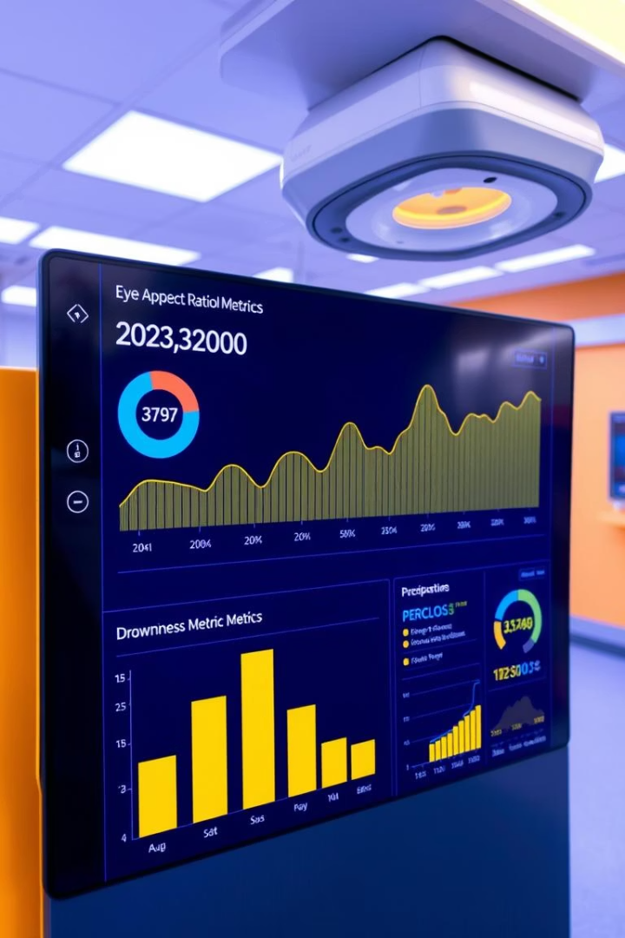
Key Metrics for Drowsiness Detection
Metric
Threshold
Description
Eye Aspect Ratio (EAR)
0.25
Below this indicates eye closure signaling drowsiness
PERCLOS
0.35 (over 5 sec)
Amount of eyelid closure over pupil triggering alerts
Head Pose Angle
30°
Nodding or tilt angle indicating fatigue

Slide 6
System Architecture and Components
Camera Module
Processing Unit
Alert System
Captures driver's face continuously in real-time.
Runs computer vision algorithms to analyze facial cues.
Delivers audio and visual warnings to the driver.
Power Supply
ADAS Integration
Powered by vehicle’s 12V power source for integration.
Optional link with advanced driver-assistance systems.

Slide 7




Real-Time Performance and Accuracy
Accuracy
Speed
1
2
92% success in detecting drowsiness under various conditions.
Processes 30 frames per second for smooth real-time analysis.
Robust Testing
Low Latency
Validated in diverse lighting and driving environments.
Alerts delivered in under 100 milliseconds to ensure prompt response.
4
3

Slide 8
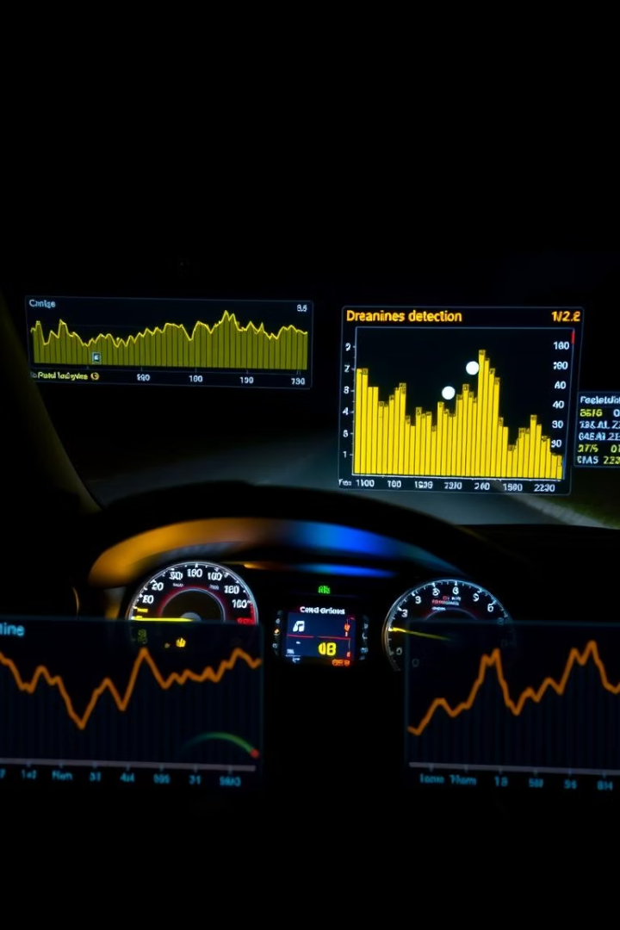
Prototype and Testing
Deployment
Tested in vehicle with 10 diverse drivers.
Data Collection
100 hours of driving data in varied scenarios gathered.
Results
85% reduction in simulated drowsy driving events recorded.
User Feedback
Drivers reported high ease of use and acceptance.

Slide 9





Future Enhancements and Applications
Vital Sign Integration
Add heart rate monitoring for better accuracy.
Cloud Connectivity
Enable remote monitoring and data analytics.
Autonomous Vehicles
Adapt system for self-driving and ADAS technologies.
Personalized Profiles
Customize drowsiness detection per driver’s behavior.
Fleet Management
Integrate with trucking companies’ management systems.

Slide 10
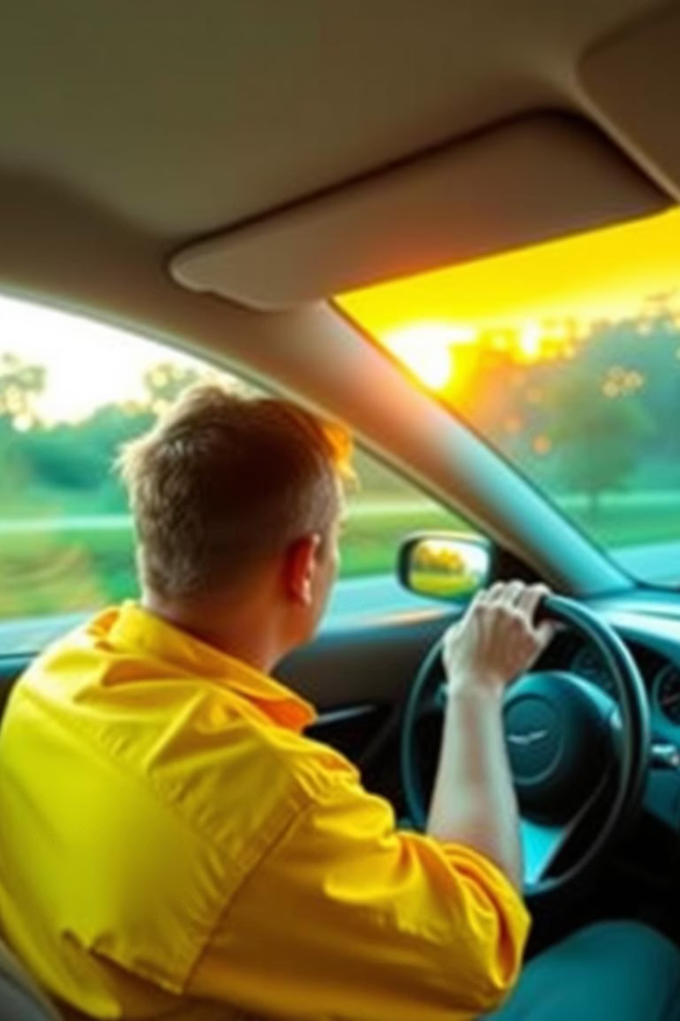
Conclusion: Enhancing Road Safety
Accident Reduction
Real-time drowsiness detection saves lives on the road.
Timely Alerts
Provides early warnings to keep drivers alert.
Scalable System
Flexible for use in various vehicle types and models.
Safer Future
Paving the way for smarter, safer road travel worldwide.

